Slide 1
Presentation
on
Project of “Full Stack Web Development”
“Pass The Book”
-an influencing E-Commerce Website

Slide 2
TEAM MEMBERS
Divya Kanwar Chundawat(18EARCS048)
Ishika Gupta(18EARCS057)
Sudhanshu Sharma(18EARCS112)

Slide 3
INTRODUCTION:
What is E-Commerce ?
It actually consists of buying and selling of goods & services over an electronic system Such as Internet & other Computer Networks.

Slide 4
PASS THE BOOK
Objective:
The Goal of this project/Website (Pass the book) to develop a web based interface For the users to buy books, in addition to it, Seller & Consumer Can directly Contact Each other , Which reduces the hesitation of Consumer To buy any book.

Slide 5
Tools & Technologies
HTML
CSS
TYPESCRIPT
MANGODB
GITHUB

Slide 6
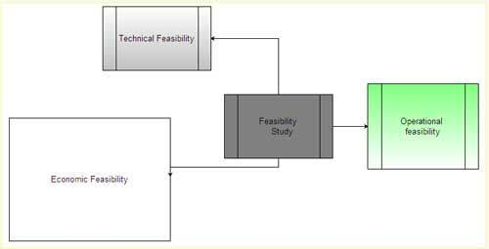
Feasibility Analysis:
Technical Feasibility
Operational Feasibility
Economical Feasibility

Slide 7
“PASS THE BOOK”
-Detailed description

Slide 8
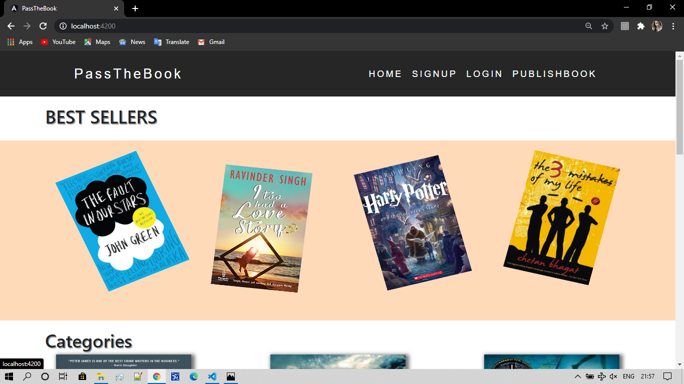
Home Page
The Home page of website, Which contains Which contains Signup, Login , Publish book option along with various categories of book displayed to attract the user.

Slide 9
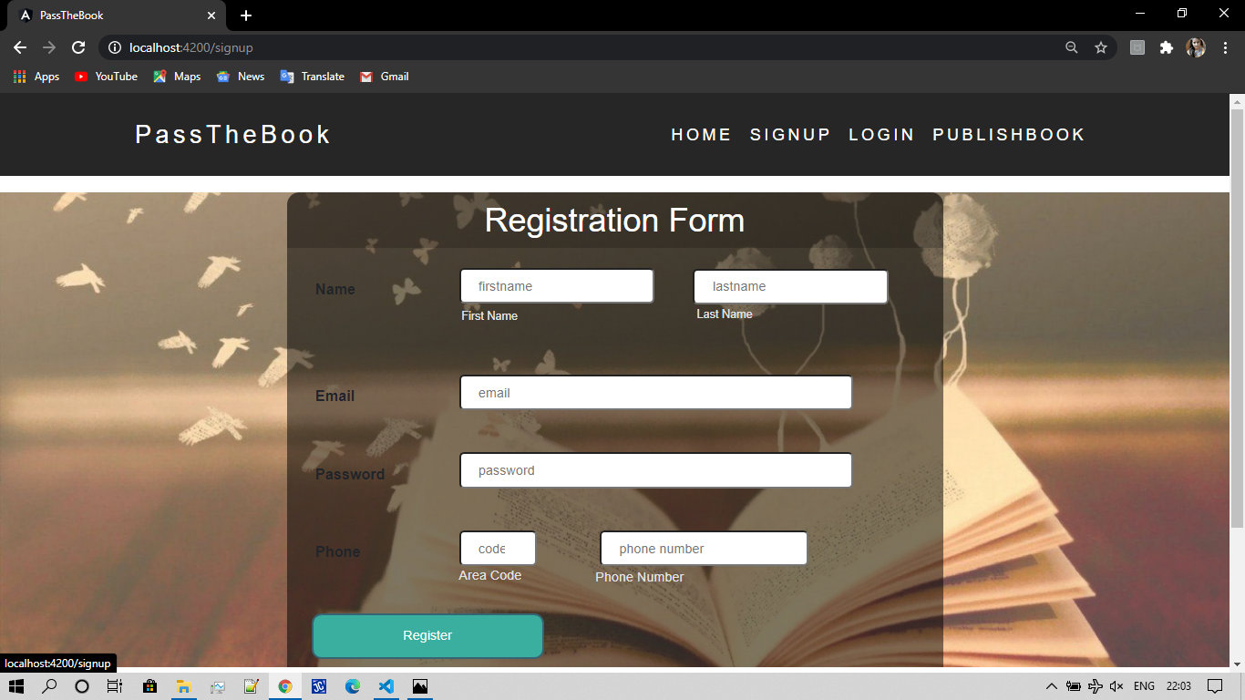
Registration Web page
This registration page is only for users who wish to become customers.

Slide 10
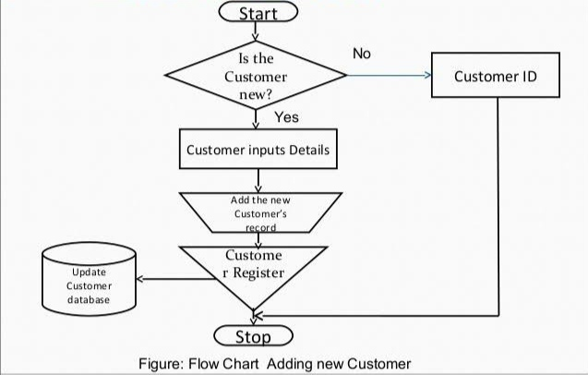
Flow Chart of adding New Customer

Slide 11
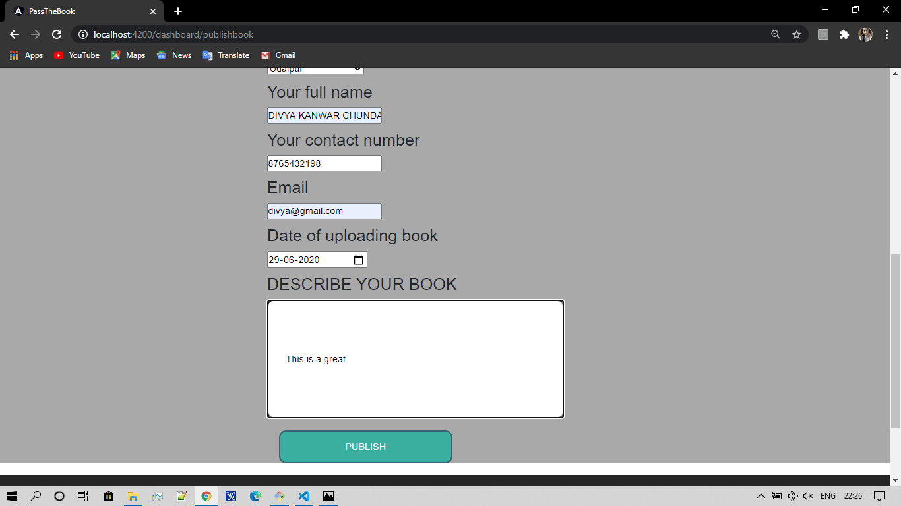
Seller Registration Web Page
This web page is for the registration of the seller on the website so that they can publish there book along with the photo of its cover.

Slide 12
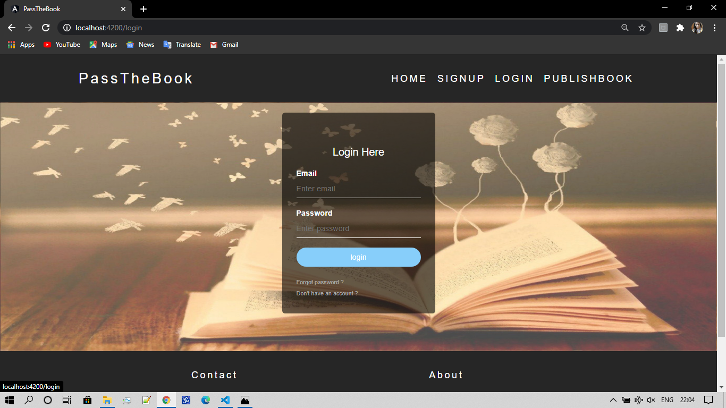
Login Web Page For Customer
Once the user has become Customer by registering to the website, he/she may Login at any instance of time & can easily browse for the book.

Slide 13
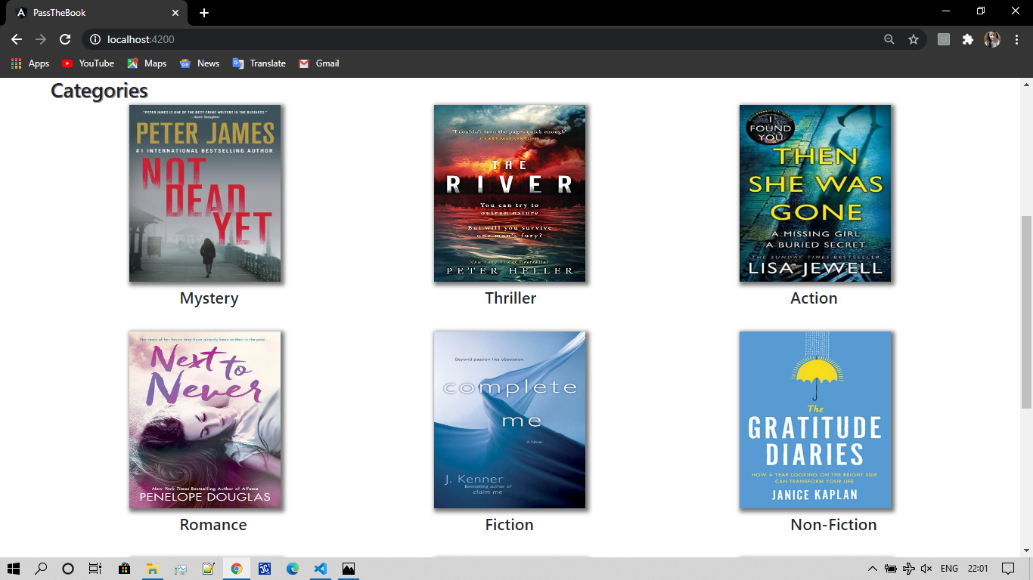
This is the Webpage showing Categories of books available At any Instance on website.

Slide 14
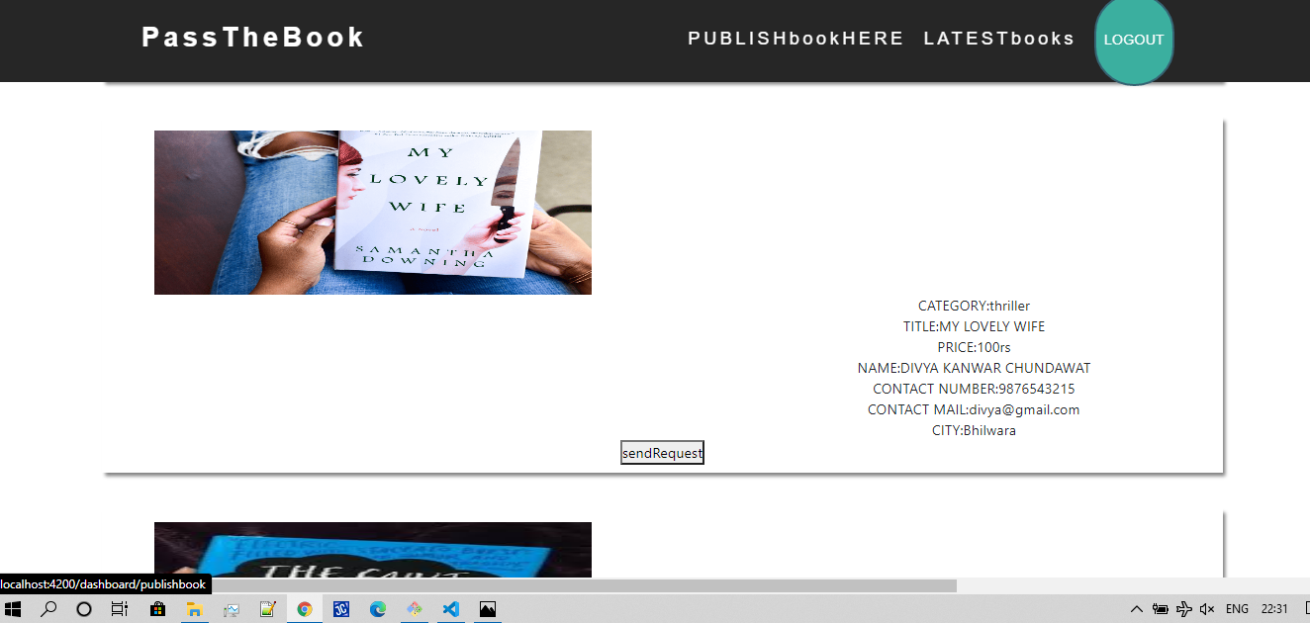
Whenever user find the book , he can accordingly send the request & Can Contact the seller through the given details.
Which ensures our aim , that user may directly contact to the Seller of the book.

Slide 15
Any Question?

Slide 16

Thank You!

